Slide 1
CHICAGO TRAFFIC CRASHES
Bharati Kandakumar | Divya Shankar | Lasya Pathuri | Snigdha Jain

Slide 2
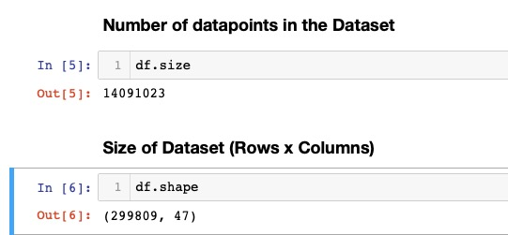
Dataset: Chicago Traffic Crashes
Traffic crashes on city streets within City of Chicago city limits under jurisdiction of Chicago Police Department
Data shown is from Electronic reporting system at CPD

Slide 3
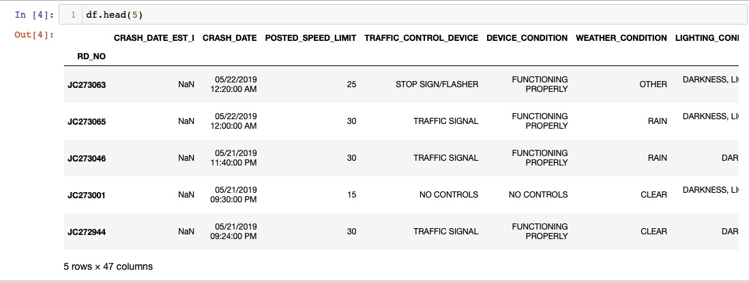
Dataset: Chicago Traffic Crashes

Slide 4
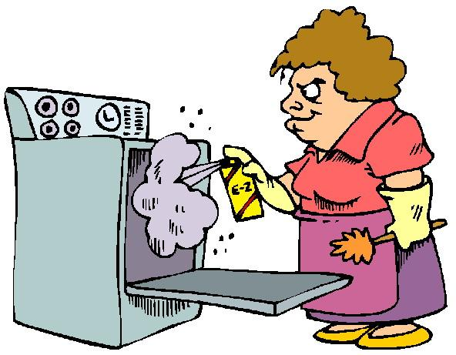
Data Cleaning

Slide 5
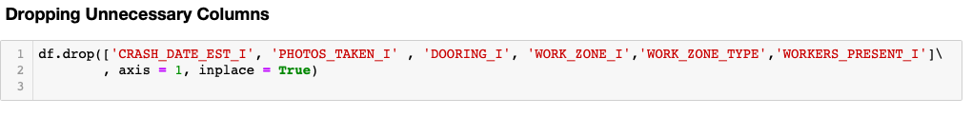

Data Cleaning
Drop Unnecessary columns
Dropping some rows which have NaN values

Slide 6
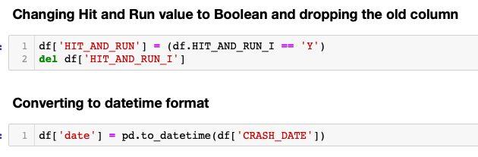

Data Cleaning
Change Data type of few columns to make suitable for analysis
Adding a column ‘Year’

Slide 7
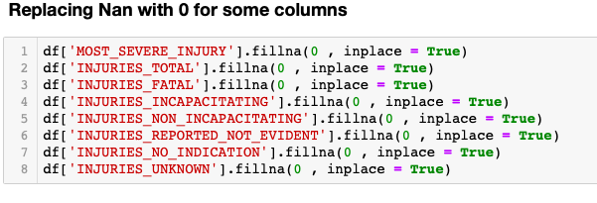
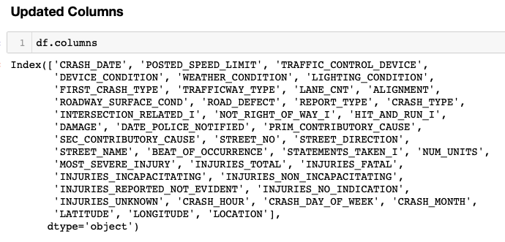
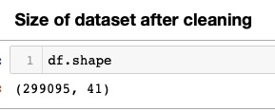
Data Cleaning
Replacing NaN with zero for some columns
Updated dataset

Slide 8
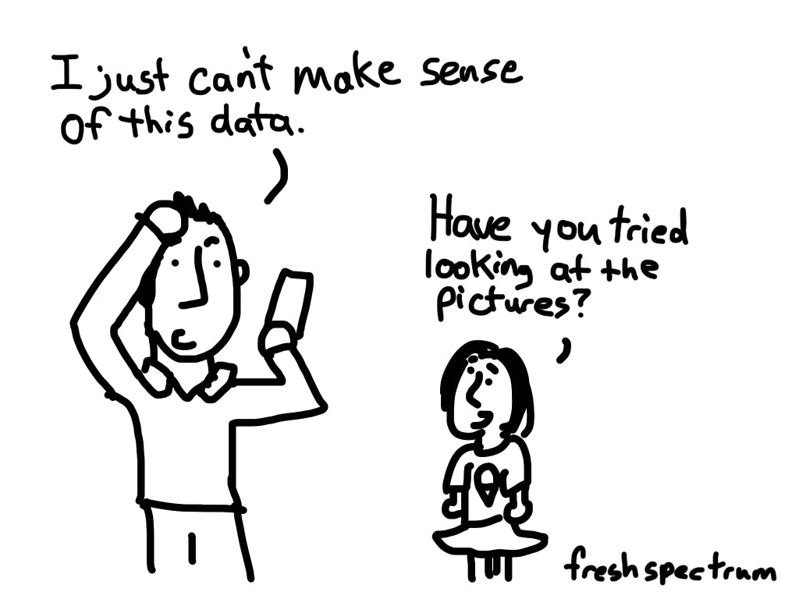
Data Analysis

Slide 9
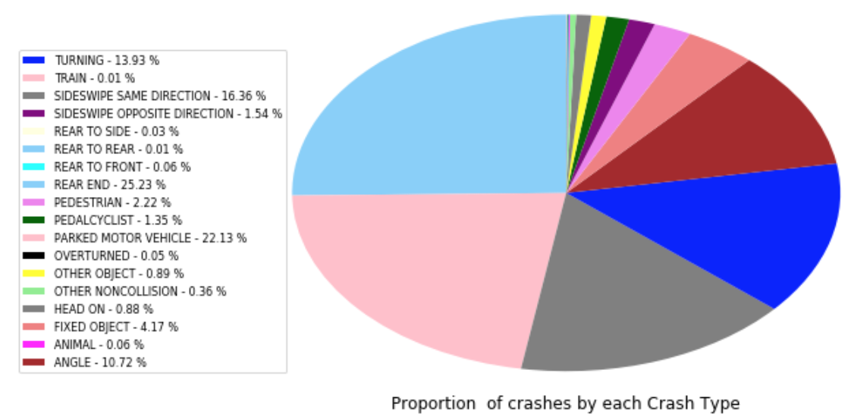
Insight 1:
Finding proportion of each crash type with reference to total number of crashes and proportion of each type of crash for each year

Slide 10
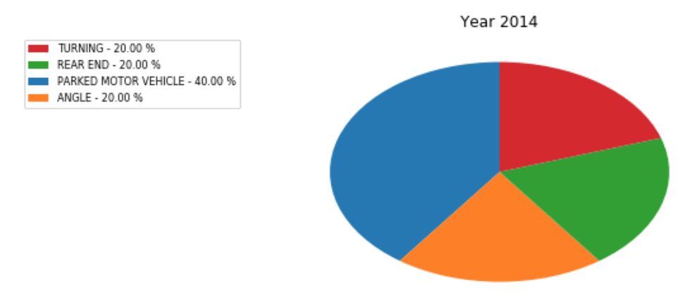
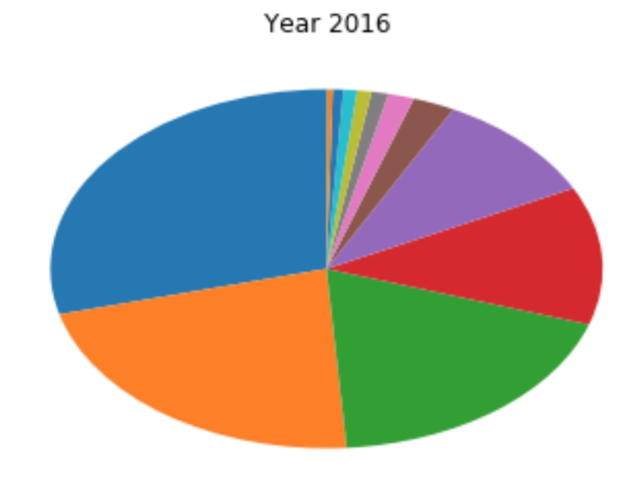
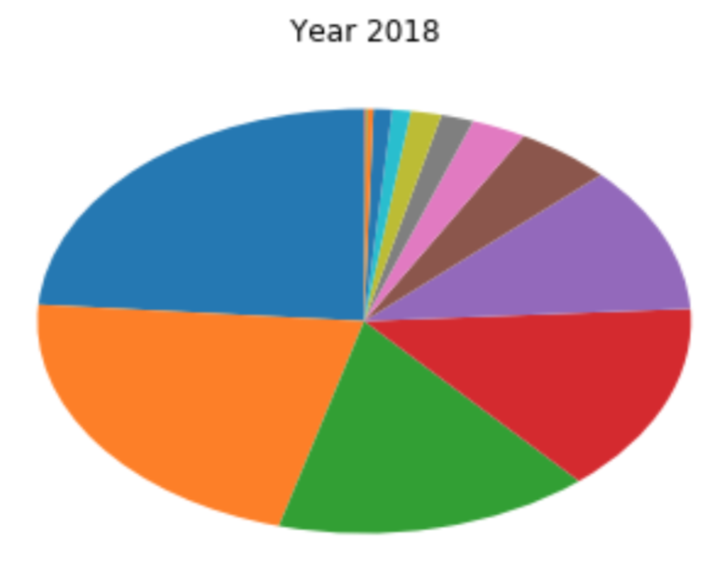
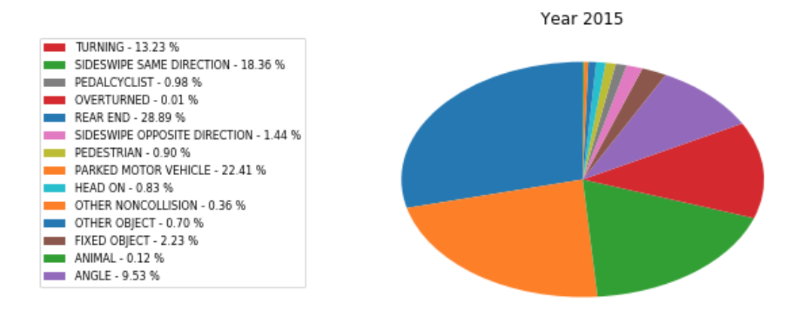
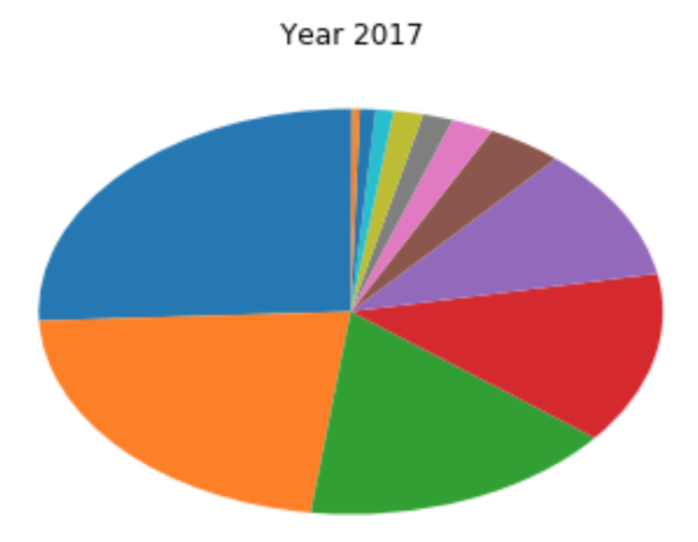
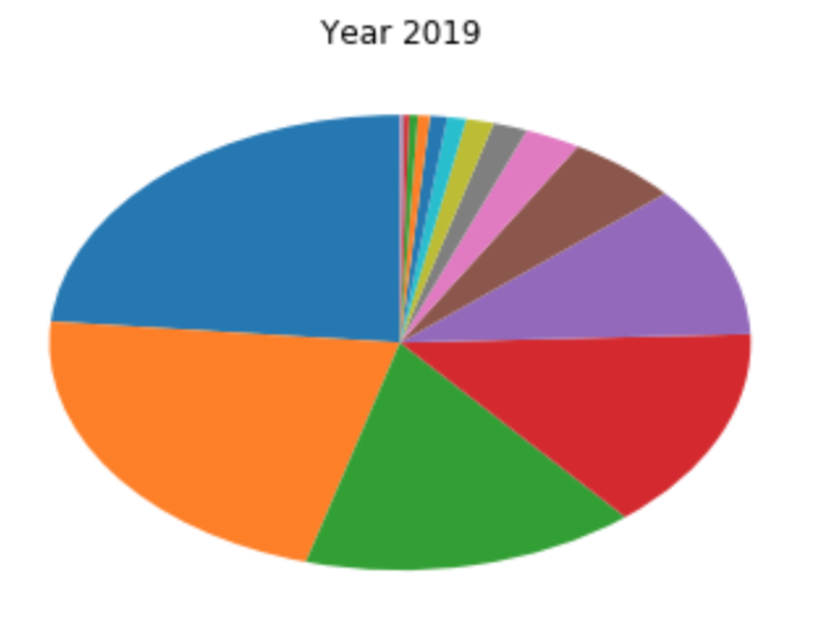

Slide 11
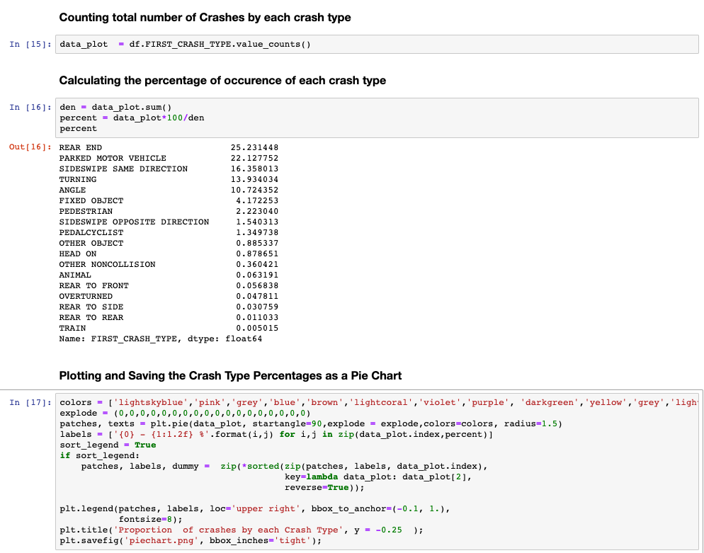

Slide 12
Inference 1:
Maximum number of crashes occur due to "rear end” ~25.23% of total number of crashes, followed by "parked motor vehicle" and "sideswipe same direction"
Crashes due to "parked motor vehicles" is the highest in 2014. May be due to:
Limited availability of data for beginning years
Later years show that number of crashes increases, and crashes due to "rear end" take a lead, fluctuating between 23%-29% over next couple of years
Suggestion: Chicago Police Department, could conduct awareness campaigns on safe driving distance and distracted driving

Slide 13
Insight 2:
Analyzing Hit and Run Cases in the following ways:
Identifying proportion of hit and run cases to number of crashes that occur by each day of week
Identifying proportion of hit and run cases to number of crashes that occur by hour of day

Slide 14
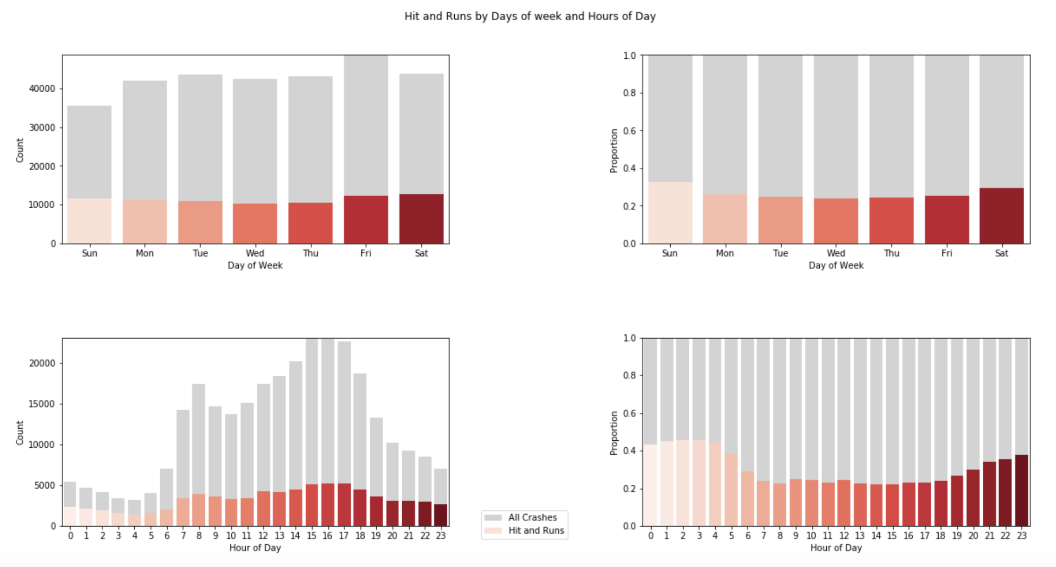

Slide 15
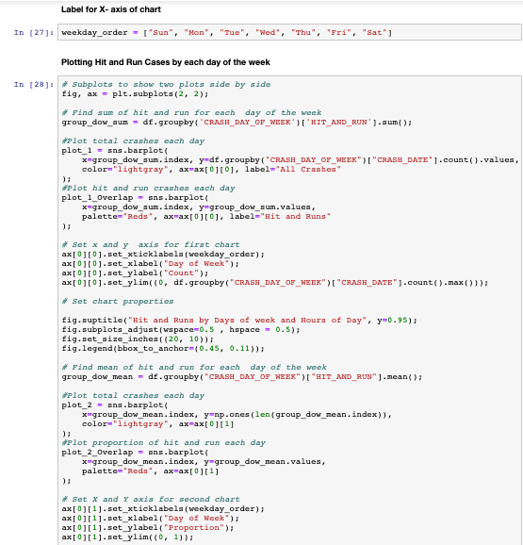
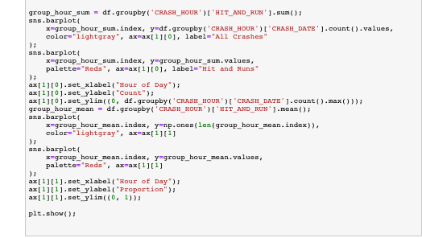

Slide 16
Inference 2:
The proportion of hit and run cases is higher on Saturday and Sunday.
The analysis by hours of day reveals that Hit and run cases are higher in late hours of day (10pm to 4am).
This could be due to following reasons:
Lack of lighting
Lack of traffic monitoring at night
Increased activity on holidays
Suggestion: Chicago Police Department could arrange for improved supervision during night hours and holidays.

Slide 17
Insight 3
Use Machine Learning “Classification Model” to classify severity of crashes in Chicago City based on following parameters:
Weather Condition
Lighting Condition
Most Severe Injury
Time of Crash/Crash Hour

Slide 18
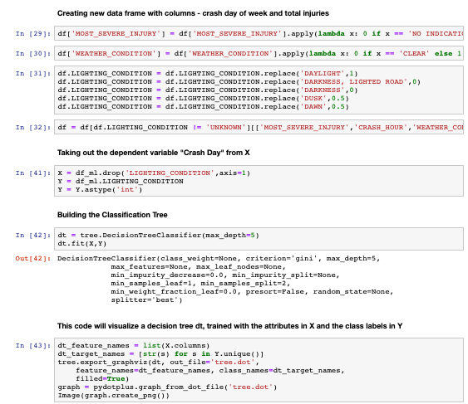

Slide 19
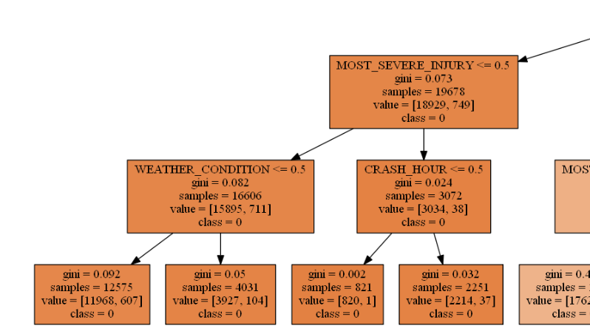
Inference
Despite Good lighting conditions, ~ quarter (27%) of severe crashes occur around midnight
Reasons: Tired/Distracted driving, over-speeding due to reduced traffic, assuming ideal driving conditions, driving under influence.
Suggestion: increased patrolling & resources around midnight

Slide 20
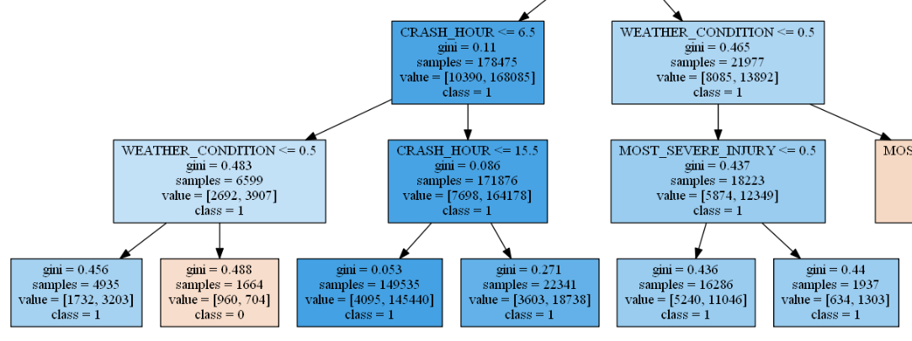
Inference
Almost 50% of the crashes that took place in Chicago between 2013 to 2019 have occurred in daylight with poor lighting conditions
Suggestion: Make daytime headlight mandatory in poor lighting condition hours/zones

Slide 21
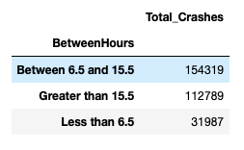
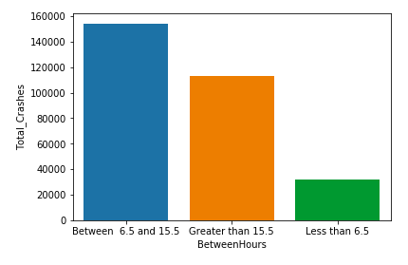
Validation
Most number of crashes occur in Chicago City during daylight hours (between 6:30am to 3:15pm)

Slide 22
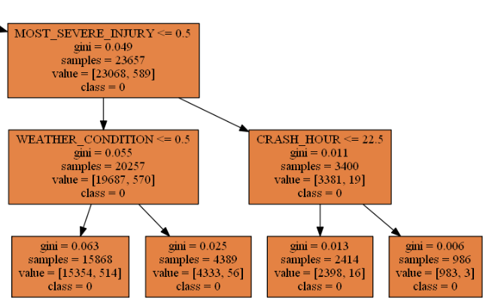
Inference
5% of total severe traffic crashes in Chicago City occur despite good weather & lighting conditions.
Reasons: Poor driving
Suggestion: Create awareness on defensive driving, improve licensing procedures

Slide 23
References
https://data.cityofchicago.org/Transportation/Traffic-Crashes-Crashes/85ca-t3if/data
https://stackoverflow.com
https://seaborn.pydata.org
https://pandas.pydata.org/pandas-docs/stable/
https://www.slidescarnival.com
https://freshspectrum.com/how-pictures-help-discover-the-unexpected/
http://www.animatedimages.org/cat-cleaning-1095.htm

Slide 24
THANK YOU Any Questions?

